Slide 1
Simulated Evolution of Non-Regular Strategies in Repeated Games
Student: Bradon Hall
Supervisor: Julian Garcia
Notes:
Hi, Im BH, and my supervisor is JG
We’re studying the Simulated Evolution of Non-Regular Strategies in Repeated Games
Let’s start with a shorter description of the project- the Games part

Slide 2
The Prisoner’s Dilemma
 | Player 2
Player 1 | Move | Cooperate | Defect
 | C | R=4, R=4 | T=5, S=1
 | D | S=1, T=5 | P=2, P=2
“Rational” players- maximise personal score
T>R>P>S
Mutual Defection is an Equilibrium (no unilateral incentive to switch from D)
Dilemma? {C,C}>{D,D}!
Symmetric!
π(C,C)<π (D,C) as R<T
π(D,C)<π(D,D) as S<P
No matter what opponent does {D} is best choice
{D,D} is dominant!
Notes:
The game I am looking at the prisoners dilemma- it simulates a simple competitive environment between 2 players.
Traditionally it is given as two criminals have been caught. They have the choice of keeping quiet- Cooperating with their partner, or Defecting- spilling the beans hoping for leniency or a deal.
Both persons choice influence both persons outcomes- the time they serve.
Here, I use a number payoff- higher is better (or a lesser sentence).
If both cooperate, they get the payoff R, Reward for Mutual Cooperation.
If both defect, they get P, the Punishment for Mutual Defection.
If Cooperates, and the other Defects, the Defector gets T, the Temptation to Defect.
The one who Cooperates gets S, the Suckers Payoff.
The defining factor for a PD game, is that payoff for Temptation beats Reward beats Punishment, beats Suckers payoff.
If we consider the opponents moves, in either case the best payoff is available if we defect.
If we assume players try to maximise their score on this one move, we expect them to go for mutual defection- it is an equilibrium and dominant.
The dilemma arises, because if they did not go with the dominant play, they would be better off.
The game I will be looking at is the Prisoner’s Dilemma
Its generally introduced as two criminals that have been caught.
They have the option of keeping quiet- cooperating, or dobbing in their partner- defecting.
They cannot communicate, it is once off, and they consider only their own benefit.
If one confesses and the other keeps quiet, the confessor gets a minimal sentence- give it score T, Temptation
If both keep quiet, they get a short sentence- give it a score R, reward for mutal cooperation
If both confess, they both get a long sentence- give it a score P, Punishment for mutual defection
If one confesses, the one who keeps quiet gets the maximum sentence- call it S the Suckers payoff
The defining factor for the PD is not the scenario, it’s the hierarchy of the payoffs.
Temptation payoff needs to be better than Reward, which needs to be better than Punishment.
The Suckers payoff is the worst.
Nash- no unilateral
Dom- no matter what other does its better

Slide 3
The Evolution of Cooperation
Population of many players, 2 play at a time
All play in a generation (once, in our case)
Payoff determines fitness
Payoff D> Payoff C? D has advantage, mutant C never conquers population of D
Relevance?
Anything where there is competition in a dynamic system
It’s interesting!
Survival of the Fittest and Cooperation?
Some Mechanisms for Cooperation
Direct Reciprocity – How long do we play?
Assortment – Who do we play with?
Notes:
I will be using the PD to study Evolution- it provides a basis to simulate competition.
Fitness is determined by payoff in playing the game
In the one off game example, 2 strategies exist: play D, play C. D gets higher fitness, and reproduces. C doesn’t.
Where is the study of strategies evolving relevant?
Anywhere where there is competition between individuals that can change
The two obvious examples are Biology and Economics
More importantly, the evolution of cooperative strategies is interesting.
Cooperative behaviour at first seems at odds with survival of the fittest, yet is seen everywhere.
A variety of mechanisms for cooperation to succeed are known.
To name a few, there is Direct Reciprocity, basically ‘you scratch my back, I’ll scratch yours’ can work if individuals meet a few times
Assortment- where strategies are more likely to play strategies like them
This could take the form of kinship; in biology, there is an advantage to helping siblings since it helps spread shared genes
In this project, we don’t specify kin selection, just some sort of assortment

Slide 4
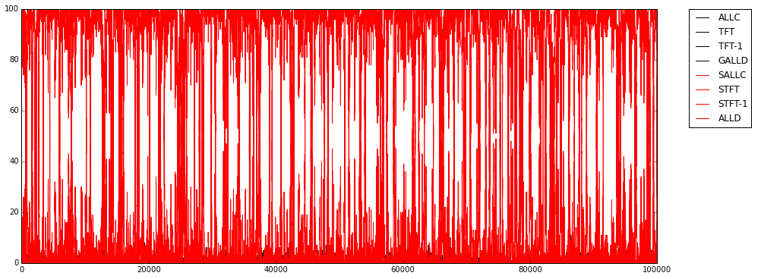
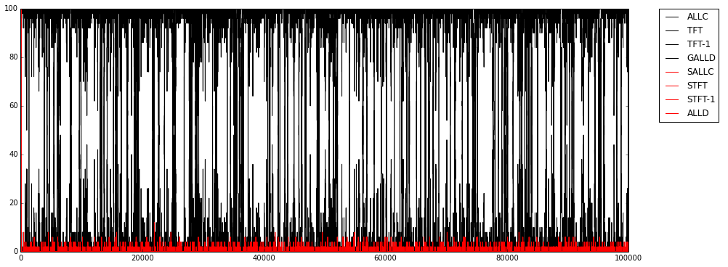
Games with Assortment
No assortment? In one shot PD, Defector wins over Cooperator
Add assortment
Parameter r=[0,1], chance to play similar strategy
1-r chance to play strategy from whole population
Cooperators can now win, if r is high enough
See Eschel & Cavlalli-Sforza 1982 and Bergstrom 2003
Notes:
In the one shot, no assortment version strategies play against a strategy selected from the population.
Because of the PD heirarchy of payoffs, Defect has a higher expected payoff
Now add assortment. The parameter r gives the chance to play a brother strategy, not looking at the population
There is a chance 1-r to play a strategy from the whole population- including brothers
If r is high enough, cooperators can now win

Slide 5





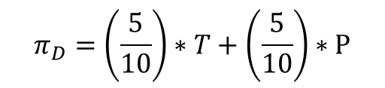
Games with Assortment – The Math
No assortment? In one shot PD, Defector wins over Cooperator
Add assortment
Parameter r=[0,1], chance to play brother strategy
1-r chance to play strategy from whole population
Cooperators can now win, if r is high enough
$π_{C}=\left(\frac{5−1}{10−1}\right)∗R+\left(\frac{5}{10−1}\right)∗$S
$π_{C}=\left(\frac{5}{10}\right)∗R+\left(\frac{5}{10}\right)∗$S
T>R, P>S
D beats C
$$π_{D}=\left(\frac{5}{10}\right)∗T+\left(\frac{5}{10}\right)∗P$$
$Π_{C}^{}=\left(1−r\right)π_{C}$+rR
$Π_{D}^{}=\left(1−r\right)π_{D}$+rP
R$>$P
See Eschel & Cavlalli-Sforza 1982 and Bergstrom 2003
Notes:
In the one shot, no assortment version strategies play against a strategy selected from the population.
Because of the PD heirarchy of payoffs, Defect has a higher expected payoff
Now add assortment. The parameter r gives the chance to play a brother strategy, not looking at the population
There is a chance 1-r to play a strategy from the whole population- including brothers
If r is high enough, cooperators can now win

Slide 6
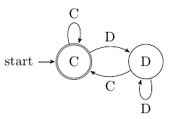
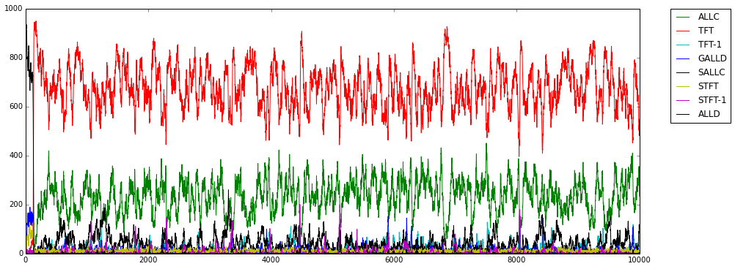
Repeated Games
Parameter delta- chance they play again
More strategies than C,D -> Now infinitely more
What strategies are successful?
Analyse? Have select examples
(cherry pick)- simulate instead
TFT | C | D | C | C | D | D..?
RAND | D | C | C | D | D | ?
Notes:
Now take the example of repeated games.
The game is played between two strategies for a probabilistically determined number of times- based on a continuation probability
C, D are no longer the only strategies- actually, there are infinite strategies
One way to find successful strategies is to pick a few. TFT is an important one- it starts cooperating, then reciprocates the opponents last move.
Instead of limiting the space, we can simulate instead.
The diagram shows the success of TFT in a game with high continuation probability.

Slide 7
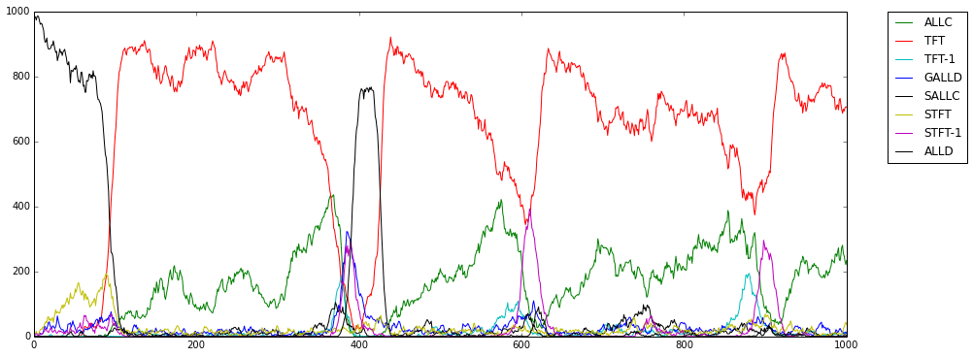
Winning the Battle, Losing the War
Winning a game, or sequence of games is good…
High payoff = high fitness, which determines who survives and reproduces
But strategies evolve- the environment changes
Notes:
Winning at the PD isnt everything.
It certainly helps- the high fitness results in staying in or increasing in the population.
But the strategies that compete will change over time.
In the diagram, ALLD has a series of victories, and for a short time is most frequent, but Tit For Tat has the advantage.

Slide 8
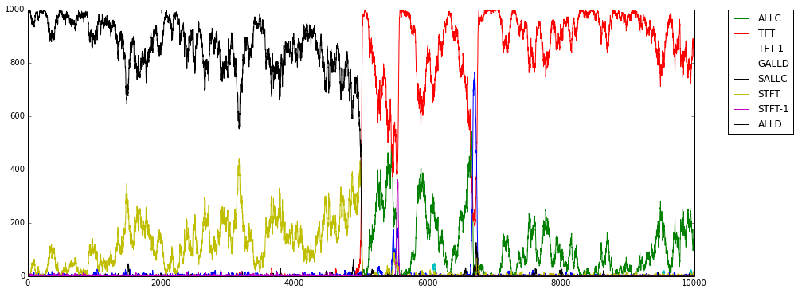
The Repeated Game is Dynamic
ALLD | D | D | D | D….
ALLC | C | C | C | C…
ALLD loses to ALLC
STFT neutral mutant of ALLD
STFT drifts into pop of ALLD
ALLC appears!
Does well with STFT
Cycles occur
ALLD | D | D | D | D…
STFT | D | D | D | D…
ALLC | C | C | C | C…
STFT | D | C | C | C…
Notes:
A mutant that plays the strategy Suspicious Tit For Tat has equal fitness when it plays ALLD.
It can enter the population by neutral drift- an example is shown below, STFT is gold, and enters and exits by drift.

Slide 9
The Repeated PD is Dynamic
ALLD: Always Defect
ALLC: Always Cooperate
STFT: Defect, then Reciprocate
Population of ALLD, with one ALLC mutant?
ALLD always gets T, best payoff
ALLC always gets S, worst payoff
ALLD reproduces with high probability
ALLC does not reproduce
ALLD | D | D | D | D | D | D | D | D | D…
ALLC | C | C | C | C | C | C | C | C | C…
Notes:
The repeated prisoners dilemma is dynamic
Take a situation where an always cooperate, always defect, and a strategy called Suspicious Tit For Tat, that defects first then reciprocates, can evolve.
In a population of ALLD, an ALLC mutant fails- ALLD gets the best payoff, the mutant gets the worst.

Slide 10
Drift
STFT can drift into a population of ALLD (Neutral Drift, Sampling Drift)
It is a neutral mutant of ALLD
ALLD | D | D | D | D | D | D | D | D…
STFT | D | D | D | D | D | D | D | D…
Notes:
A mutant that plays the strategy Suspicious Tit For Tat has equal fitness when it plays ALLD.
It can enter the population by neutral drift- an example is shown below, STFT is gold, and enters and exits by drift.

Slide 11

Indirect Invasion
In my example STFT becomes common by neutral drift
ALLC mutant appears!
ALLC plays STFT
STFT wins (one Temptation payoff). But ALLC does well!
Use simulations to study behaviour
ALLC | C | C | C | C | C | C | C | C…
STFT | D | C | C | C | C | C | C | C…
van Veelen et. al 2012
Notes:
Say STFT becomes common by drift.
ALLC does better playing STFT than ALLD does playing STFT!
So, an ALLC mutant can survive and grow if STFT is common enough.
Simulation allows for analysis of a broader set of strategies.

Slide 12
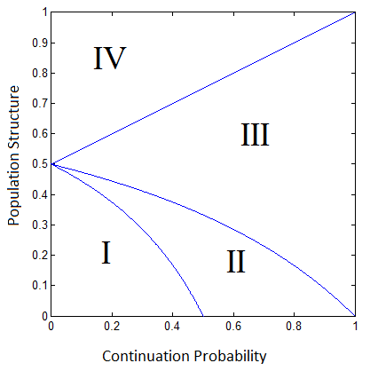
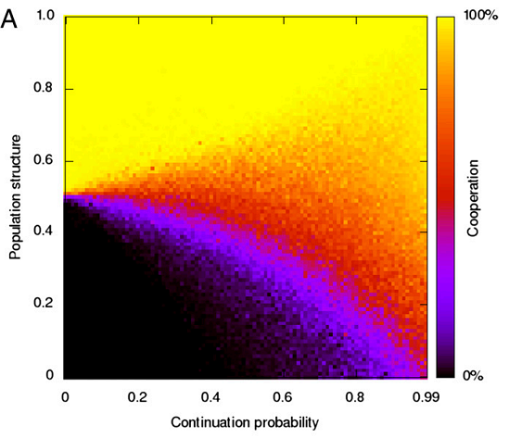
Relevant Research
The relation between Direct Reciprocity, Population Structure, and Cooperation
Analysis- regions
van Veelen et. al. 2012
Notes:
My project is based on work from my supervisor and colleagues- they studied the relation between direct reciprocity, population structure and cooperation
They analysed the strategies that could be successful in different regions of a map of population structure and continuation probability.
I – Always Defect
No cooperation- Always defect is an equilibrium, and no cooperator is an equilibrium
II – Mixture
Some cooperation- cooperators invade, always defect is still an equilibrium
III- Mixture, complete defectors not an equilibrium
Lots of cooperation, no complete defector is an equilibrium
IV – Always cooperate
Mostly cooperation, cooperators can invade all defectors
These results are not representation specific, I expect them to hold for any large strategy space.

Slide 13
Representations- Lookup Table
Sequence of {C,D}
Example- base on opponents last move
 | Initial | Respond to C | Respond to D
ALLC | C | C | C
ALLD | D | D | D
TFT | C | C | D
STFT | D | C | D
Notes:
A simple representation is the lookup table. The first bit says what to do initially, the next two show how to respond to cooperation or defection.
Adding extra bits, and it has a longer memory.
Want a larger strategy space? Add more memory.
Mutations are easy- flip a random bit.
Mutation Distance between strategies is easy to see. ALLC is 3 C’s, ALLD is 3D’s- 3 bit flips are required to change one into the other- a distance of 3.
This captures a lot of the known successful strategies- eg TFT
This is what I have been using for prototyping the simulation

Slide 14
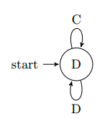
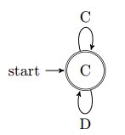
Finite State Automata
History of moves is a sequence of {C,D}
FSAs define a regular language
Is history in the language?
No! Defect
Yes! Cooperate
Notes:
Another representation is the FSA.
If you do not restrict states, you do not restrict the strategy space- it could be any regular language.
To run the automaton, you start at the start state. You read from the history of moves, following transition lines.
When you finish, if you are on an accept state- one with two circles, you cooperate. Otherwise, you defect.
The examples are ALLC, ALLD, TFT.
Transitions are a little harder- you have the option of adding nodes, removing them, changing acceptance states, and changing transitions.

Slide 15
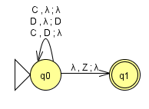
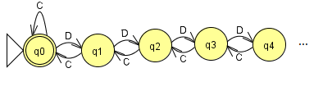
Larger Strategy Spaces
Push-Down Automata
Includes all Regular strategies, plus Context-Free strategies
Infinite loops to deal with
Example?
CCC-Accept, CCCD – Reject, CCCDC – Accept, CCCDDCDDC- Reject
See Sipser 2006, JFLAP
Notes:
PushDown Automata is the next step up in the language heirarchy.
It includes all FSA, plus a heap more.
It is more complex, and problems like infinite loops occur.
An example of a non-regular strategy is C repeated n times, D repeated n times.
It’s not very interesting though, it cooperates at most once, and is otherwise ALLD.
Ive given a more meaningful example.
It does the equivalent of starting at the end of the history, and counting D’s and C’s moving backwards.
If D’s ever outnumber C’s, it defects.
It picks up a grudge immediately, and it holds it until a very good apology is given.
An equivalent FSA requires infinite states, the PDA needs 2.

Slide 16
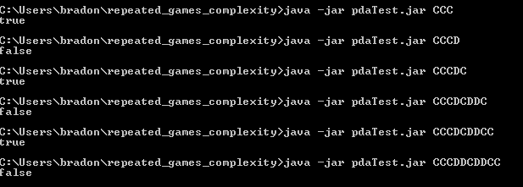
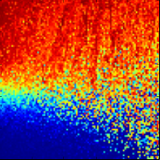
What Have I Done
Literature search on potential representations
A simulation that models strategies with 3 bit lookup tables
With varied population structure
With varied continuity probability
Uses van Veelen et. al. simulation, but with representation implementation by me. (https://github.com/juliangarcia/agentbased)
Notes:
So far I have completed a literature search on representations, and decided to focus on lookup tables and PDA.
I’ve extended Julians publically released simulation, with lookup tables, and created tools for analysing them- the frequency graphs over generations I showed.
Initial results show the regions do appear- but I need to improve the resolution of that image.

Slide 17
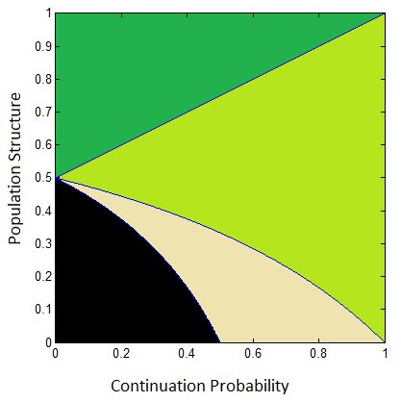
What’s Next
Behaviour regions- Lookup Table
Add PDA representation
JFLAP
Compare to expected result
Any differences to FSA?
Why?
Notes:
Next, I need to improve the lookup table analysis, and maybe try bigger tables.
I need to add PDA. This will be made easier by using JFLAP.
I only need to program the mutations.
JFLAP will also detect some infinite loops- but I’ve only thrown a few at it so far.
How to deal with these needs to be explored.
After this the results need to be analysed.

Slide 18
Possible Results - I
Nothing!
PDA strategy space includes all regular strategies
If all successful Context-Free strategies are also Regular- identical result
Notes:
The first possible result is that nothing new or interesting appears in the simulation.
PDAs can represent all FSAs too. If there are no strategies that do well that a PDA can do, but an FSA cant, no new results are expected

Slide 19
Possible Results - II
Regions Match
Expected
Different patterns might emerge
Tends to be more cooperative than regular strategies
Tends to be less cooperative
Tendency changes in regions
Automata may be more complex
In summary, I will explore the impact the representation of strategies has on the evolution of strategies
Notes:
The regions identified are expected to remain the same.
Different patterns might emerged- the more computationally powerful PDA might be less, or more cooperative.
The automata may be more complex.
Unique strategies, or high-performing ones might appear.
In summary, I will explore the impact the representation of strategies has on the evolution of strategies

Slide 20
References
van Veelen, M., Garcia, J., Rand, D. G. and Nowak, M. A. (2012). Direct reciprocity in structured populations, Proceedings of the National Academy of Sciences USA 109: 9929–9934.
Sipser, M. (2006). Introduction to the Theory of Computation, Second Edition, Course Technology, Boston.
Bergstrom, T. C. (2003). The algebra of assortative encounters and the evolution of cooperation, International Game Theory Review 5(03): 211–228.
JFLAP, www.jflap.org (Accessed 9 Jun 2014)
Agent Based Evolutionary Dynamics, https://github.com/juliangarcia/agentbased, (Accessed 9 Jun 2014)
Eshel, I., & Cavalli-Sforza, L. L. (1982). Assortment of encounters and evolution of cooperativeness. Proceedings of the National Academy of Sciences, 79(4), 1331-1335.
Notes:
Any questions?

